Slide 1
Java collections
by Lien Nguyen

Slide 2
Java Collections
Overview
Collection
Set
List
Queue
Deque
Map
Object Ordering
SortedSet
SortedMap

Slide 3
Overview
A Collection is a container that groups similar elements into an entity.
The Collections framework in Java offers a unified approach to store, retrieve and manipulate a group of data
Collection Framework Interfaces:
Collection
Map
Set
List
Queue
Deque
SortedMap
SortedSet

Slide 4
Collection Framework Intefaces
Collection: This interface is pretty much used in declarations and method signatures so any type of Collections can be passed around.
Set: A Collection interface that cannot take any duplicate elements.
List: An ordered Collection interface that allows duplicate elements and provides object retrieval based on an integer index.

Slide 5
Collection Framework Intefaces
Queue: an ordered Collection following the FIFO (First In First Out) principles.
Deque: can be used both as FIFO and LIFO.
Map: Supports Collection of key and value pairs. Design does not allow duplicate keys.
Sorted Set: Ordered version of the set interface.
Sorted Map: Maintains ascending order of keys.

Slide 6
Operations Supported by Collection <E> interface
boolean isEmpty();
boolean contains (Object element);
boolean remove (Object element);
Interface <E> iterator();
boolean containsAll (Collection <?> C);
boolean addAll (Collection <? extends E> C);
boolean removeAll (Collection<?> C);
boolean retainAll (Collection <?> C);
void clear();
Object[ ] toArray();
T[ ] toArray(T[ ]a);

Slide 7
for-each Construct
Traverse a collection or array using a for loop
for(Object o : collection)
System.out.println(o)

Slide 8
Iterator
Public interface Iterator<E>
{
boolean hasNext();
E next();
void remove();
}
Allow to traverse through a collection
static void loopThrough(Collection col)
{
for (Iterator <E> iter = col.iterator();iter.hasnext();)
{
Object obj=iter.next();
}
}
Allow to remove the current element
static void loopThrough(Collection col)
{
for (Iterator <E> iter = col.iterator();iter.hasnext();)
{
if(check(iter.next()))
{
it.remove();
}
}
}

Slide 9
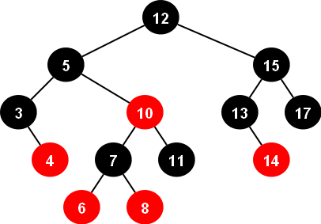
Set
Set
HashSet
TreeSet
LinkedHashSet
 | HashSet | TreeSet | LinkedHashSet
Storage Type | HashTable | Red-Black Tree | HashTable with a Linked List
Performance | Best performance | Slower than HashSet | Little costly than HashSet
Order of Iteration | No guarantee of order of iteration | Order based | Orders elements based on insertion
Note:
HashTable:
contains key and value pairs
is synchronized
Red-Black Tree is a binary search tree
in which each node is colored red or black such that
The root is black
The children of a red node are black
Every path from the root to a 0-node or a 1-node
has the same number of black nodes.

Slide 10
List
Benefits
Positional access and search operations
public static<String> void swap(List<String>strList, int k, int l)
{
String strTmp = strList.get(l);
strList.set(k,strList.get(l));
strList.set(l,strTmp);
}
Customized Iteration
for(ListIterator<String> lIter=strList.listIterator(strList.size());lIter.hasPrevious())
{
String str = lIter.previous();
}
for(ListIterator<String> lIter=strList.listIterator(strList.size());lIter.hasNext())
{
String str = lIter.next();
}
Range-View operation
List l= list.subList(fromIndex, toIndex);

Slide 11
List
List
Arraylist
Vector
Linkedlist
 | ArrayList | Vector | LinkedList
Storage Type | Array | Array | Array with Deque
Performance | Best performance | Slower than ArrayList, fail-fast | Little costly than ArrayList
Order of Iteration | Orders elements based on insertion | Orders elements based on insertion | Orders elements based on insertion

Slide 12
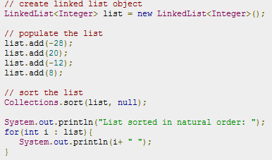

List Algorithms
These methods are static and belong to Collections class
sort: sort a list using a merge sort algorithm
public static <T extends comparable<? super T>> void sort(List<T> list)
public static<T> void sort(List<T> list, comparator<? super T> c)
shuffle: Randomly permute elements
public static void shuffle(List<?> list)
public static void shuffle(List<?> list, Random rnd)
reverse: Reverses order of elements
public static void reverse(List<?> list)

Slide 13
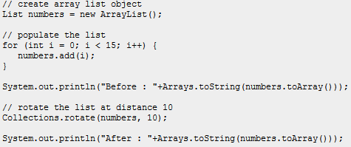

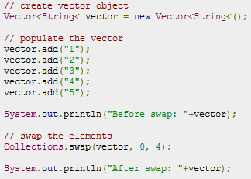

List Algorithms
rotate: Rotates list by specified number
public static void rotate(List<?> list, int distance)
swap: swaps the elements at specified positions
public static void swap(List<?> list, int i, int j)
public static void swap(Object[] arr, int i, int j)

Slide 14
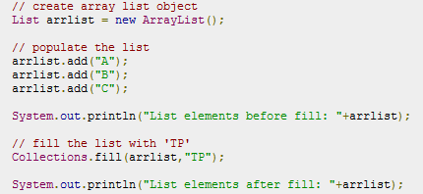

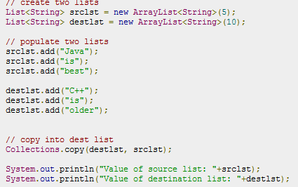

List Algorithms
replaceAll: replaces all occurrences of one specified value with another
public static <T> boolean replaceAll(List<T> list, T oldVal, T newVal)
fill: Overwrites every element with specified element.
public static <T> void fill(List<? super T> list, T obj)
copy: Copies source list into destination.
public static <T> void copy(List<? Super T> dest, List<? Super T> src)

Slide 15
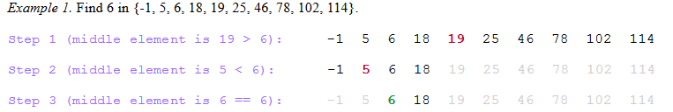
List Algorithms
binarySearch: Performs search usng binary search.
public static <T> int binarySearch(List<? extends comparable<? super T>> list, T key)
indexOfSubList: Returns index of first subList found.
public static int indexOfSubList(List<?> source, List<?> target)
lastIndexOfSubList: Returns index of the last subList found
public static int lastIndexOfSubList(List<?> source, List<?> target)
Note: Binary Search Algorithm
get the middle element;
if the middle element equals to the searched value, the algorithm stops;
otherwise, two cases are possible:
searched value is less, than the middle element. In this case, go to the step 1 for the part of the array, before middle element.
searched value is greater, than the middle element. In this case, go to the step 1 for the part of the array, after middle element.

Slide 16
Queue
public interface Queue<E> extends Collection<E>
{
E element();
boolean offer (E e);
E peek();
E poll();
E remove();
}
 | Purpose | Throw Exception | Return Special Value
Insert | Inserts an elements to the queue | add(obj) | offer(obj)
Remove | Remove head of the queue and return it. | remove() | poll()
Examine | Return the head of the queue | element() | peek()

Slide 17
Deque
Deque
ArrayDeque
LinkedList
 | Purpose | First Element (Beginning of the Deque instance) | Last Element (End of the Deque instance)
Insert | Inserts an elements to the queue | addFirst(e) offerFirst(e) | addLast(e) offerLast(e)
Remove | Remove head of the queue and return it. | removeFirst() pollFirst() | removeLast() pollLast()
Examine | Return the head of the queue | getFirst() peekFirst() | getLast() peekLast()

Slide 18
Map
Basic operations:
V put (Object key);
V get (Object key);
V remove (Object key);
boolean containsKey (Object key);
boolean containsValue (Object value);
int size();
boolean isEmpty();
Bulk services
void putAll(Map<? extends Key, ? extends Val> map);
void clear();
Collection Views
Set<K> keySet();
Collection<V> values();
Set<Maps.Entry<K,V>> entrySet();
MultiMaps: a map can contain another Collection to make a multimap → each key in map can have multiple values.
Map<String, List<String>> m = new HashMap<String, List<String>>();

Slide 19
Map
Map
HashMap
TreeMap
LinkedHashMap
 | HashMap | TreeMap | LinkedHashMap
Storage Type | Hash Table | Red-Black Tree | Hash Table with a Linked List
Performance | Best performance | Slower than HashMap | Little costly than HashMap
Order of Iteration | No guarantee of order of iteration | Order based | Orders elements based on insertion

Slide 20
Object Ordering
Classes Implementing comparable
Class | Natural Ordering
Byte | Signed numerical
Character | Unsigned numerical
Long | Signed numerical
Integer | Signed numerical
Short | Signed numerical
Double | Signed numerical
Float | Signed numerical
BigInteger | Signed numerical
BigDecimal | Signed numerical
Class | Natural Ordering
Boolean | Boolean.FALSE < Boolean.TRUE
File | System dependent lexicographic on path name
String | Lexicographic
Date | Chronological
CollationKey | Locale-specific lexicographic

Slide 21
Object Ordering
Other objects have to implement Comparable interface , hashcode() and equals() method.
import java.util.*;
public class Name implements Comparable<Name>
{
private final String firstName, lastName;
public Name(String firstName, String lastName)
{
if (firstName == null || lastName == null)
throw new NullPointerException();
this.firstName = firstName;
this.lastName = lastName;
}
public boolean equals(Object o)
{
if (!(o instanceof Name))
return false;
Name n = (Name) o;
return n.firstName.equals(firstName) && n.lastName.equals(lastName);
}
public int hashCode()
{
return 31*firstName.hashCode() + lastName.hashCode();
}
public int compareTo(Name n)
{
int lastCmp = lastName.compareTo(n.lastName);
return (lastCmp != 0 ? lastCmp : firstName.compareTo(n.firstName));
}
}

Slide 22
Object Ordering
Or implement Comparator interface
import java.util.Comparator;
public class MyIntComparable implements Comparator<Integer>
{
@Override
public int compare(Integer o1, Integer o2)
{
return (o1>o2 ? -1 : (o1==o2 ? 0 : 1));
}
}
// Sort anagram groups according to size
Collections.sort(winners, new Comparator<List<String>>() {
public int compare(List<String> o1, List<String> o2)
{
return o2.size() - o1.size();
}});

Slide 23
SortedSet
SortedSet stores elements in ascending order as per the natural ordering or as defined by a comparator provided at instantiation time.
Additional Services provided:
SortedSet <E> subSet (E fromElement, E toElement);
SortedSet <E> headSet (E toElement);
SortedSet <E> tailSet (E fromElement);
E element first();
E element last();
Comparator <? Super E> comparator();

Slide 24
SortedMap
Organizes data in ascending order based on natural ordering of the keys or a comparator supplied at instantiation time.
Services provided in addition to Map interface:
Comparator <? super K> comparator();
SortedMap<K, V> subMap(K from, K to);
SortedMap<K, V> headMap (K to);
SortedMap<K, V> tailMap (K from);
K firstKey();
K lastKey();

Slide 25
References
http://www.tutorialspoint.com/java/util/java_util_collections.htm
http://docs.oracle.com/javase/tutorial/collections/interfaces/index.html

